Slide 1


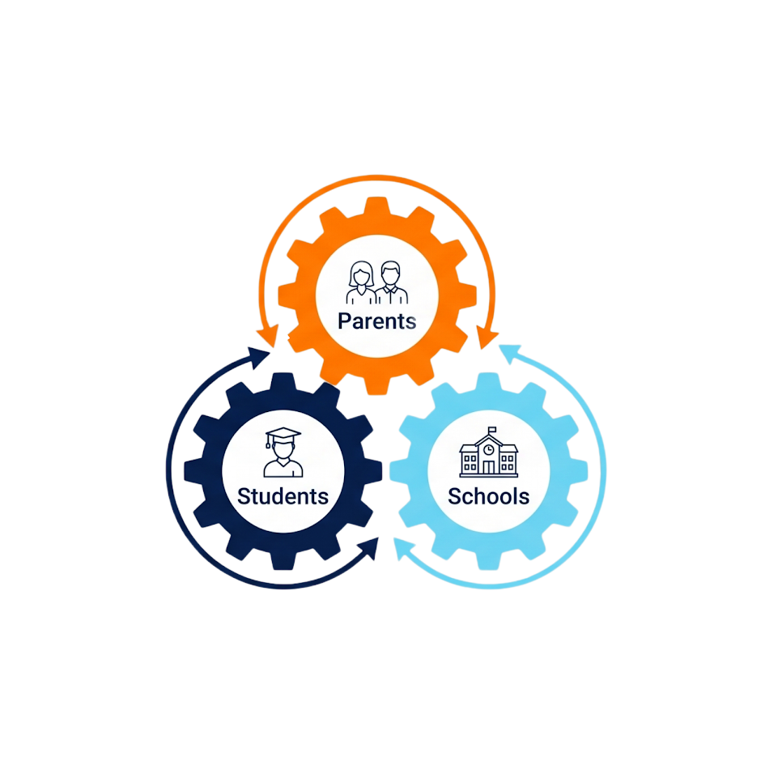

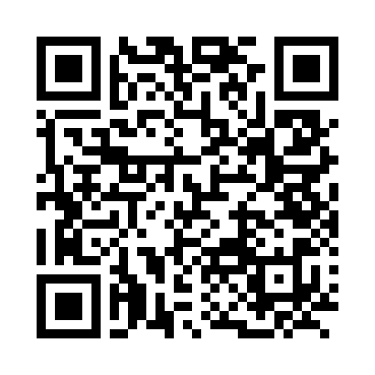
BACK-TO-SCHOOL NEEDS ONE MORE
CONVERSATION THIS YEAR:
AI.
Homework has changed. Studying has changed.
Families and schools need to be on the same page
about how AI should be used.
Parents. Students. Schools.
On the same page.
FREE NATIONAL FAMILY AI GAME PLAN™ EVENT
Open to all parents, caregivers, and educators.
Individual registration is required to attend live or receive the on-demand replay.
SEPTEMBER 23, 2026
5 PM PT | 7 PM CT | 8 PM ET
LIVE + ON-DEMAND REPLAY
RESERVE YOUR FREE SPOT
We expect to reach capacity.
SCAN TO REGISTER
back-to-school-fall2026.discoveringai.org

Slide 2

BACK-TO-SCHOOL NEEDS ONE MORE
CONVERSATION THIS YEAR:
AI.
Homework has changed. Studying has changed.
Families and schools need to be on the same page
about how AI should be used.
Parents. Students. Schools.
On the same page.
FREE NATIONAL FAMILY AI GAME PLAN™ EVENT
Open to all parents, caregivers, and educators.
Individual registration is required to attend live or receive the on-demand replay.
SEPTEMBER 23, 2026
5 PM PT | 7 PM CT | 8 PM ET
LIVE + ON-DEMAND REPLAY
RESERVE YOUR FREE SPOT
We expect to reach capacity.
SCAN TO REGISTER
back-to-school-fall2026.discoveringai.org

Slide 3

BACK-TO-SCHOOL NEEDS ONE MORE
CONVERSATION THIS YEAR:
AI.
Homework has changed. Studying has changed.
Families and schools need to be on the same page
about how AI should be used.
Parents. Students. Schools.
On the same page.
FREE NATIONAL FAMILY AI GAME PLAN™ EVENT
Open to all parents, caregivers, and educators.
Individual registration is required to attend live or receive the on-demand replay.
SEPTEMBER 23, 2026
5 PM PT | 7 PM CT | 8 PM ET
LIVE + ON-DEMAND REPLAY
RESERVE YOUR FREE SPOT
We expect to reach capacity.
SCAN TO REGISTER
back-to-school-fall2026.discoveringai.org

Slide 4

BACK-TO-SCHOOL NEEDS ONE MORE
CONVERSATION THIS YEAR:
AI.
Homework has changed. Studying has changed.
Families and schools need to be on the same page
about how AI should be used.
Parents. Students. Schools.
On the same page.
FREE NATIONAL FAMILY AI GAME PLAN™ EVENT
Open to all parents, caregivers, and educators.
Individual registration is required to attend live or receive the on-demand replay.
SEPTEMBER 23, 2026
5 PM PT | 7 PM CT | 8 PM ET
LIVE + ON-DEMAND REPLAY
RESERVE YOUR FREE SPOT
We expect to reach capacity.
SCAN TO REGISTER
back-to-school-fall2026.discoveringai.org

Slide 5

BACK-TO-SCHOOL NEEDS ONE MORE
CONVERSATION THIS YEAR:
AI.
Homework has changed. Studying has changed.
Families and schools need to be on the same page
about how AI should be used.
Parents. Students. Schools.
On the same page.
FREE NATIONAL FAMILY AI GAME PLAN™ EVENT
Open to all parents, caregivers, and educators.
Individual registration is required to attend live or receive the on-demand replay.
SEPTEMBER 23, 2026
5 PM PT | 7 PM CT | 8 PM ET
LIVE + ON-DEMAND REPLAY
RESERVE YOUR FREE SPOT
We expect to reach capacity.
SCAN TO REGISTER
back-to-school-fall2026.discoveringai.org

