Slide 1


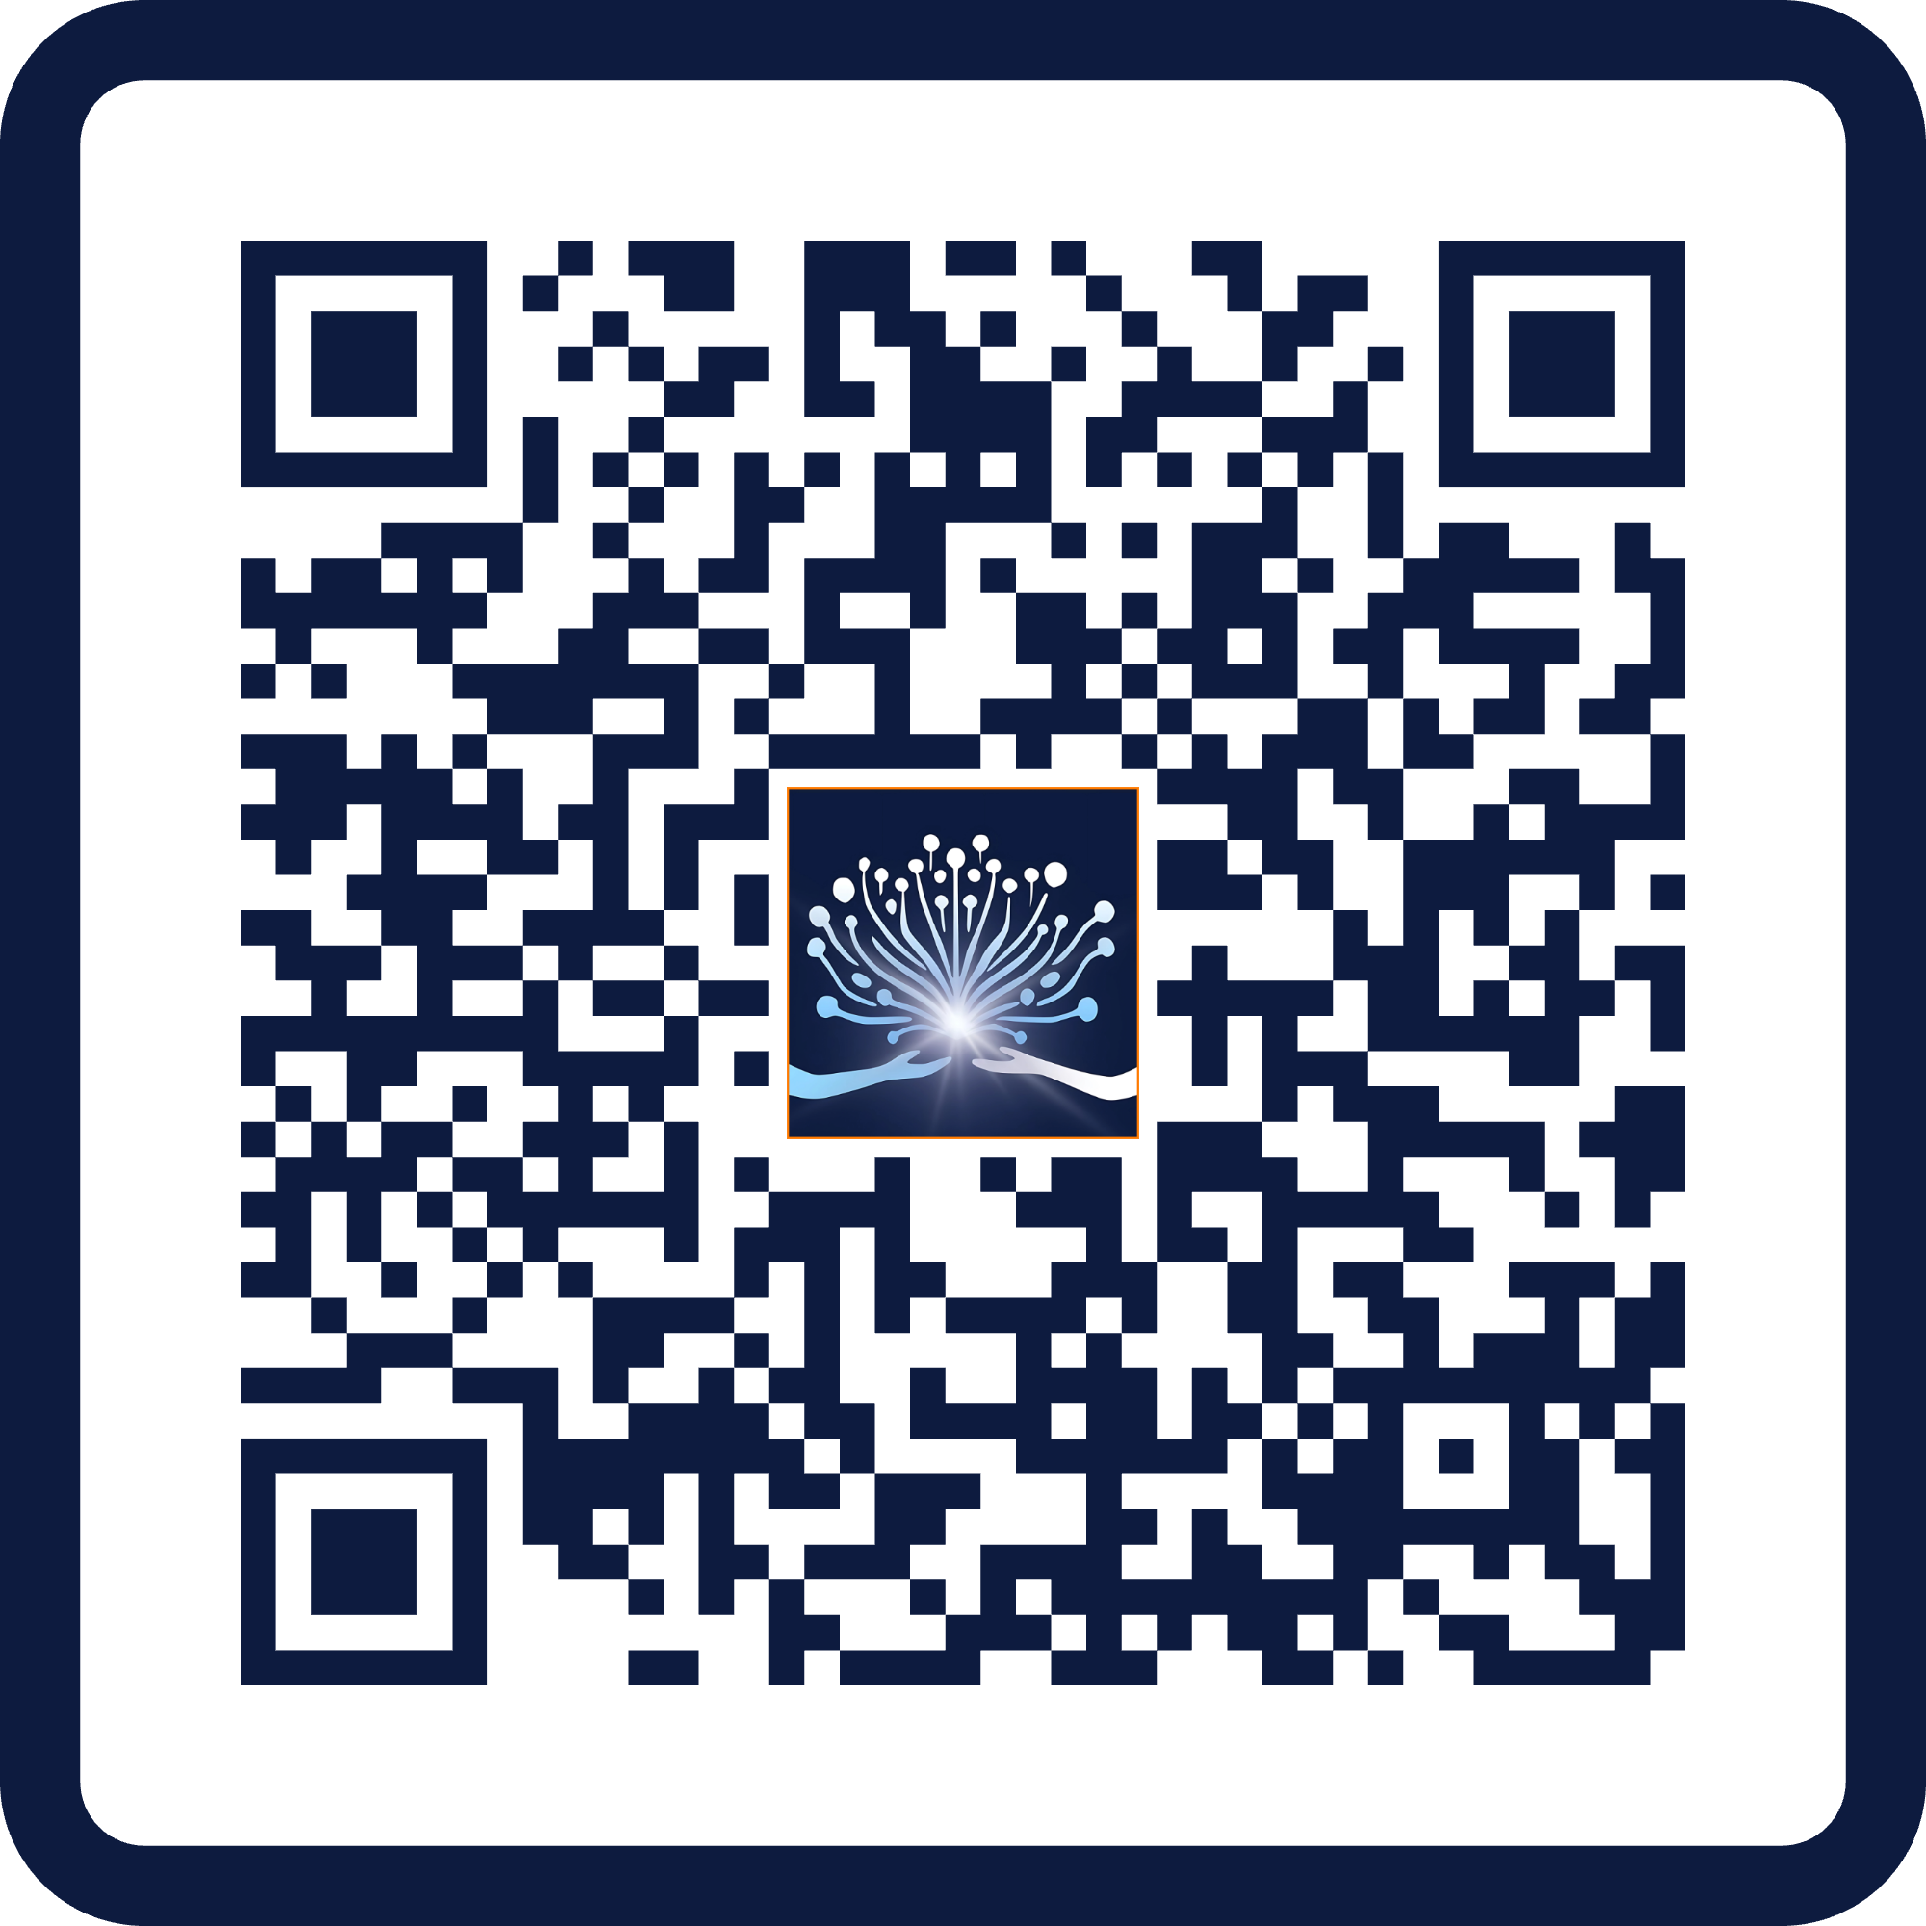
Slide for School Back-to-School Nights [update names & delete this note]
[INSERT School Name] Invites You to:
"Let’s work together to prepare every
student for success in the Age of AI!"
[Insert Principal’s Name]
Why Attend?
What to Expect?
Designed to help every household have a real
Family AI Conversation.
Practical session hosted by Amy Love, the nation’s leading voice on AI alignment for families.
Get the tools to align with our school’s AI guidelines, ensuring clear, consistent support at home and in class.
Answers to your biggest questions and a step-by- step plan for safe, productive AI use at home.
Prepare your child for success in a world where
AI is already shaping how we learn, work, and live.
Walk away with clarity, confidence, and a shared understanding across our school community.
It’s Free — Registration is Required
Your attendance is strongly encouraged!
Join live or watch on demand — just scan to register!
Notes:
Here’s a concise script the principal can read while showing the slide during Back-to-School Night. It’s warm, direct, and clearly explains what the event is, why it matters, and what parents need to do:
Principal’s Script for Back-to-School Night Slide:
“Before we wrap up, I want to personally invite every family to a special event we’re supporting this year.. the Annual National Back-to-School AI Game Plan event
This is more than just a webinar. It’s a practical, parent-focused session designed to help every household know exactly how to guide your child’s use of AI, at home and in alignment with schools.
You’ll get answers to the most common questions parents have and you’ll walk away with a simple plan for having these crucial conversations at home, all while staying aligned with our school’s expectations.
The event is hosted by Amy Love, who’s recognized nationally for helping schools and families get on the same page about technology and student success. It’s free for all families, though you do need to register to get the link. You can join live, or if your schedule’s tight, register anyway and you’ll get on-demand access to watch when it works for you.
Just scan the QR code on the screen, and you’ll be all set.
We want every family to feel confident and supported in this new era. We can’t do it alone. We need your partnership to help our students thrive.”

Slide 2
Script to read with prior slide at
Back-to-School Nights
Principal’s (or designated leader) Script for Back-to-School Night Slide:
“Before we wrap up, I want to personally invite every family to a special event we’re supporting this year…the Back-to-School Family AI Game Plan event
This is more than just a webinar. It’s a practical, parent-focused session designed to help every household know exactly how to guide your child’s use of AI, at home and in alignment with schools.
You’ll get answers to the most common questions parents have and you’ll walk away with a simple plan for having these crucial conversations at home, all while staying aligned with our school’s expectations.
The event is hosted by Amy Love, who’s recognized nationally for helping schools and families get on the same page about technology and student success. It’s free for all families, though you do need to register to get the link. You can join live, or if your schedule’s tight, register anyway and you’ll get on-demand access to watch when it works for you.
Just scan the QR code on the screen, and you’ll be all set.
We want every family to feel confident and supported in this new era. We can’t do it alone. We need your partnership to help our students thrive.”
Notes:
On slide 15, you have a possible script for the leaders on their Back to School Nights. The script looks great, but could I make a few suggestions around the phrase: "the Annual National Back-to-School AI Game Plan event":
If we call it a National event, it will make the parents feel (and the leaders receiving this wonder) if this is an event that isn't personalized to Spring families. That they're all just being added into an existing event.
While I hope we make this annual, if we tell the families it is Annual but then it doesn't end up happening we could risk not delivering on our promises. Can we just call it an "AI Game Plan Event" "Back-to-School AI Game Plan event"?

